Slide 1
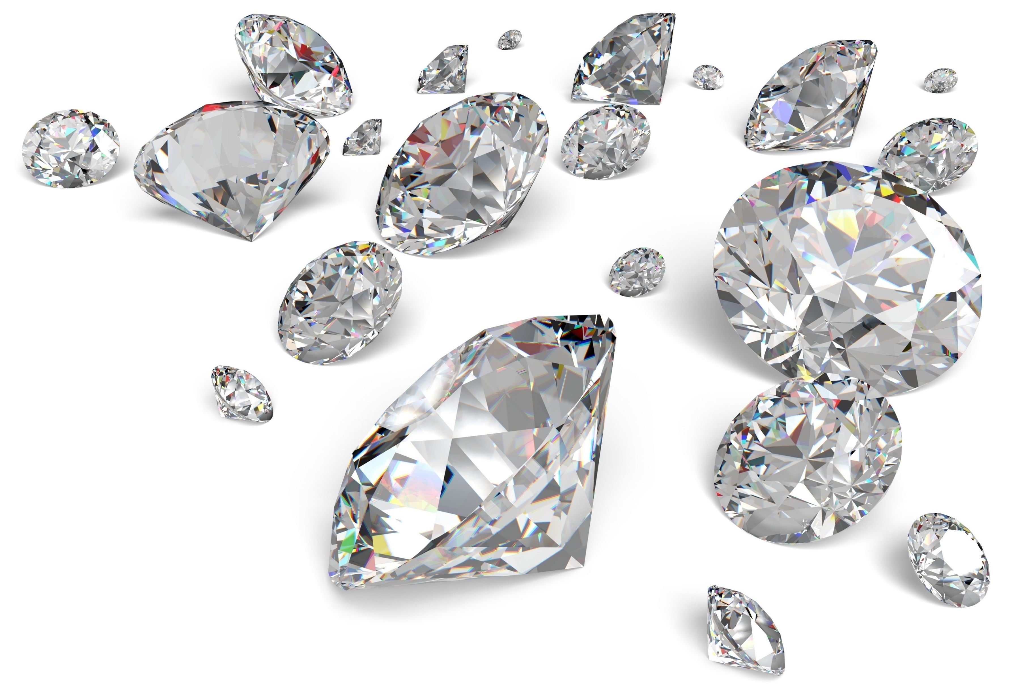
Diamonds
…are a data scientist’s best friend?

Slide 2
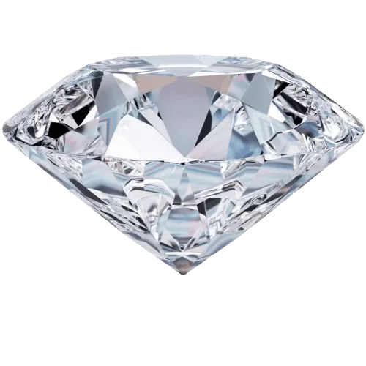
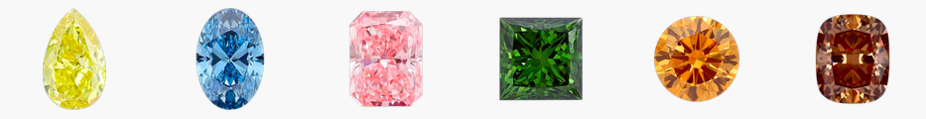
The largest diamond dataset currently on Kaggle
219,703 graded diamonds
25 columns (14 used in analysis)
Mixture of “fancy” (colored) and traditional (clear) stones
traditional
fancy
Notes:
cut, color, and clarity are all ordered categorical variables

Slide 3
3 models
Supervised regression
Can a model predict the price of a diamond?
Supervised Classification
Can a model distinguish colored diamonds from clear diamonds even if the color columns are missing?
Unsupervised classification
Can DBSCAN discover any clusters within the data?

Slide 4
Dataset

Slide 5
Columns
Columns not discarded during data cleaning:
color: The graded diamond color. Applies to clear diamonds only.
clarity: The amount of internal imperfections visible with jewelers loupe.
carat weight: The mass of a diamond. 1 carat is 200 milligrams.
cut quality: The degree to which the diamonds cut (or shape) is to perfection.
symmetry: How close is the diamond is to being perfectly symmetrical.
polish: The degree of surface scratches or inclusions present.
cut: The cut of the diamond. Alternatively called its shape.
dominant color: The primary color for a fancy diamond
culet size: The pointed facet at the bottom of a diamond.
depth percent: The diamond's total height divided by its total width.
table percent: The flat part of diamond's area as a percent of its overall footprint.
girdle min: The thickness of the thinnest section that divides the upper section (crown) from the bottom (pavilion).
girdle max: The thickness of the thickest section that divides the upper section (crown) from the bottom (pavilion).
total sales price: Total price for the stone, priced in dollars.
ordered categorical (‘ordinal’)
unordered categorical (‘nominal’)
continuous numeric
Notes:
(not relevant, too many null values, highly correlated with other variables).

Slide 6
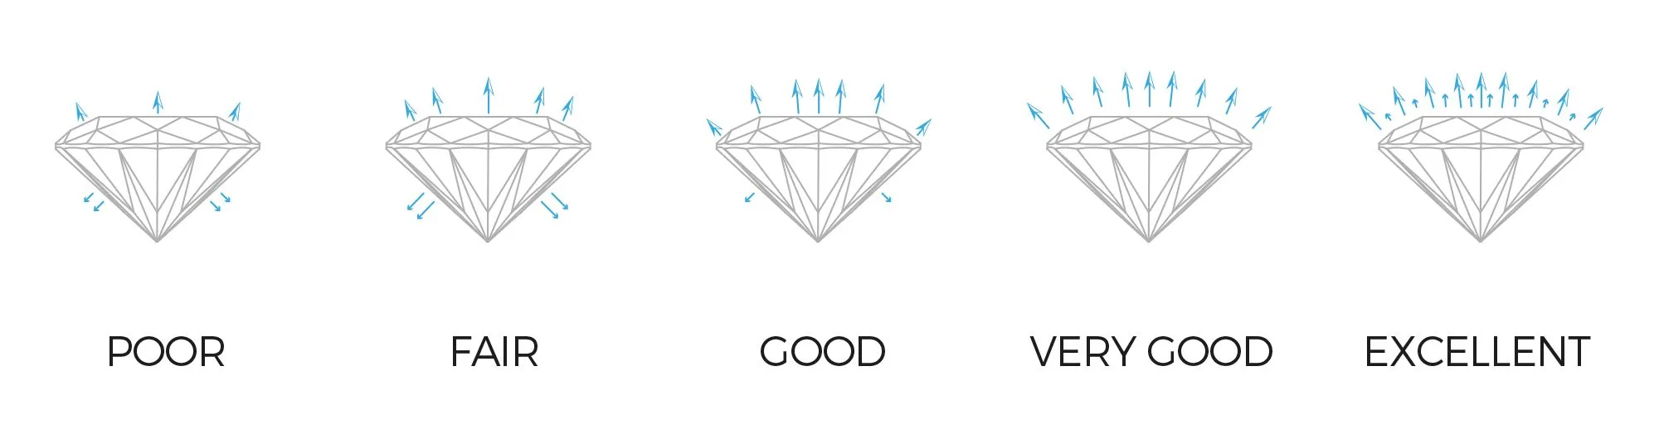
Cut (quality)
Quality of the cut affects the “sparkliness” of a diamond.
FAIR
GOOD
VERY GOOD
PREMIUM
IDEAL
Notes:
https://www.abelini.com/diamond-cut

Slide 7
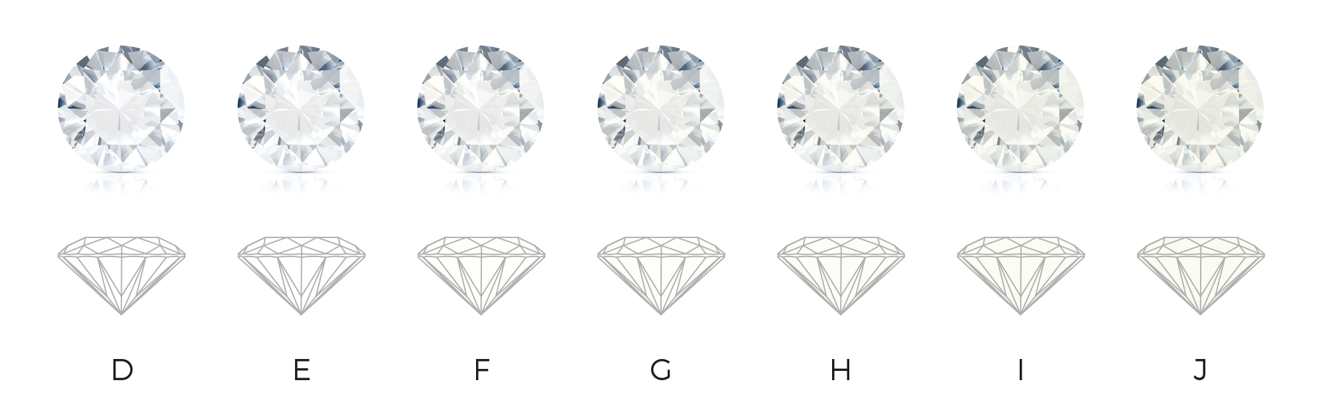
Color (assessment on clear diamonds)
Most diamonds will appear devoid of color, but there will always be either brown or yellow hints.
D
E
F
G
H
I
J
A stronger hint is considered to be of lower quality and therefore lesser worth.
Notes:
https://www.abelini.com/diamond-colour

Slide 8
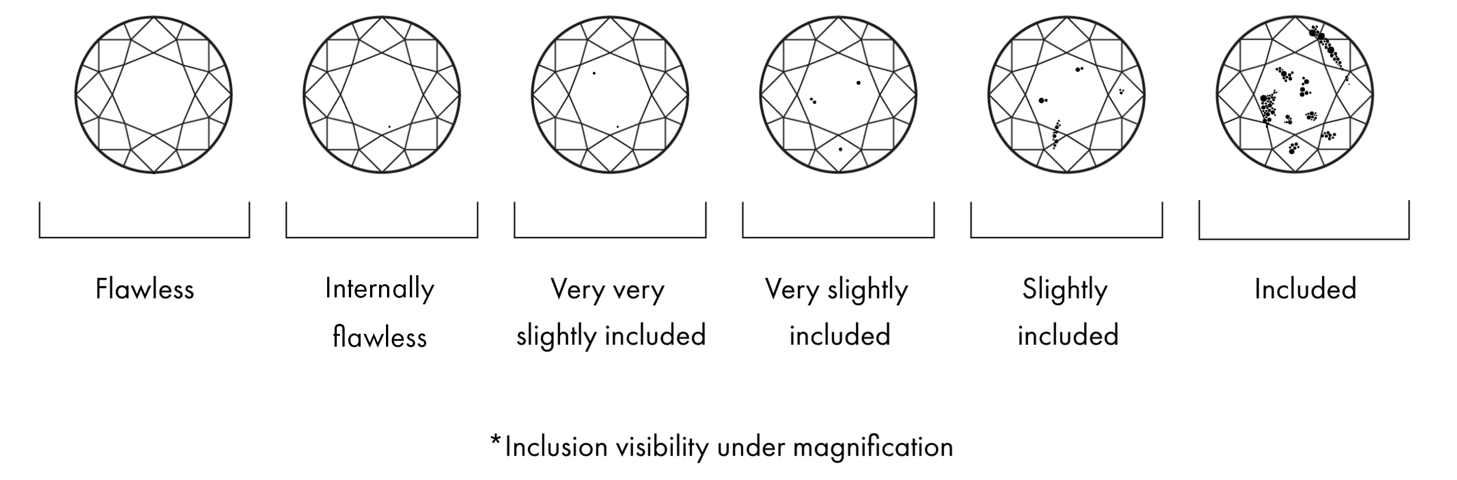
Clarity (visual purity)
Determined by (lack of) inclusions and blemishes.
FL
IF
VVS1
VVS2
VS1
VS2
SI1
SI2
I1 I2 I3
Clarity is difficult to notice without the help of a magnifier.
Notes:
https://www.vrai.com/journal/post/diamond-clarity-chart

Slide 9
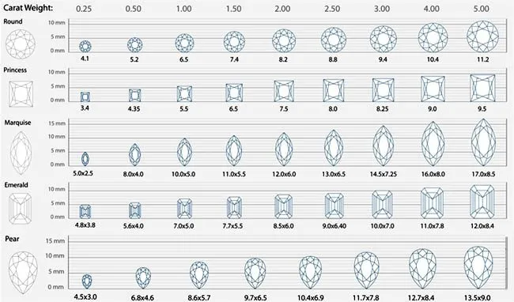
Carat (weight)
Of the “4 Cs” this is the only numerical variable. 1 carat = 200 milligrams.

Slide 10
Other assessments
Table: The top, flat facet
Crown: The top part of the diamond
Girdle: Thin perimeter around the widest part
Pavilion: The bottom part of the diamond
Culet: Bottom facet. A larger culet can create a visual “hole” or dark spot at the bottom of the diamond.

Slide 11
Initial cleaning & prep

Slide 12
Initial cleaning
Read ‘unknown’ as NaN.
Removed 3,387 duplicated rows.
Removed lab column (assume this has no effect on values).
Encoded categorical variables:
Ordered categorical values use label encoding (1, 2, 3,…) to preserve order.
Variables ordered from worst to best so that poorer ratings would correspond with lower numbers.
Unordered categorical values use dummy (‘one-hot’) encodings.

Slide 13
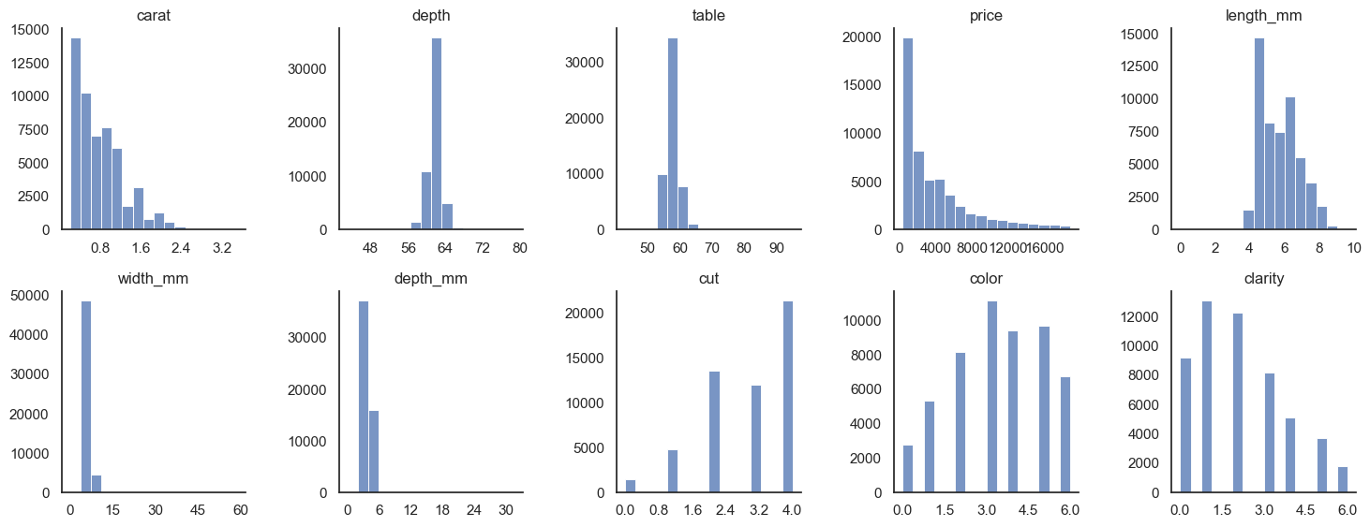
Inspection
Several of the variables are not normally distributed

Slide 14
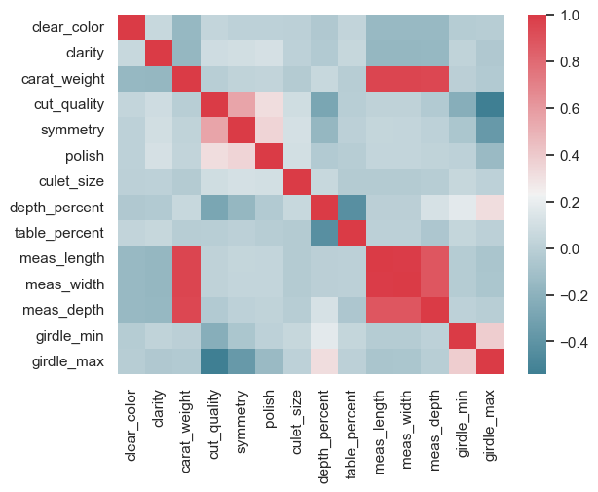
Correlation
Alternative correlation coefficient: Kendall’s τ.
Unlike Pearson’s coefficient,
Can be used on non-normal continuous variables
Can be used on ordinal categorical data
The 3 volume measurements (height, width, depth) were (not surprisingly) highly correlated with carat weight.
→ Removed these columns
High correlation between volume measurements & carat weight

Slide 15
Models

Slide 16
Linear regression: Predicting price
What would a person or dealer expect to pay or receive for a diamond?
Separate models for fancy vs. clear diamonds
Some of the columns only pertained to one or the other
Fancy diamond data missing a lot of assessments that were present in the clear diamonds subset.

Slide 17
Results
Fancy diamonds
Clear diamonds
44%
62%
R²
R²

Slide 18
Random forest: Predicting fancy/clear
If we know the diamond specs not related to color, and the purchase price, can we predict if it was a fancy or clear diamond?
Combined data set (fancy & clear diamonds)
Labeled each diamond as fancy/not fancy
Removed color columns (fancy color name, clear color quality)
Balanced Random Forest, since fancy diamonds only make up about 10% of the data.

Slide 19
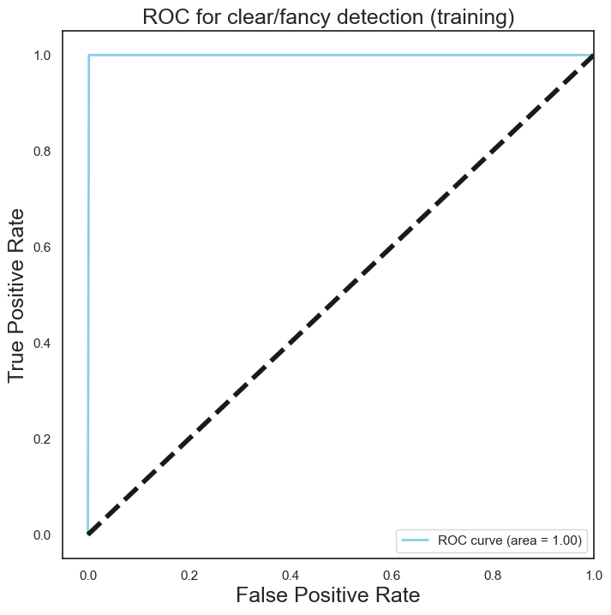
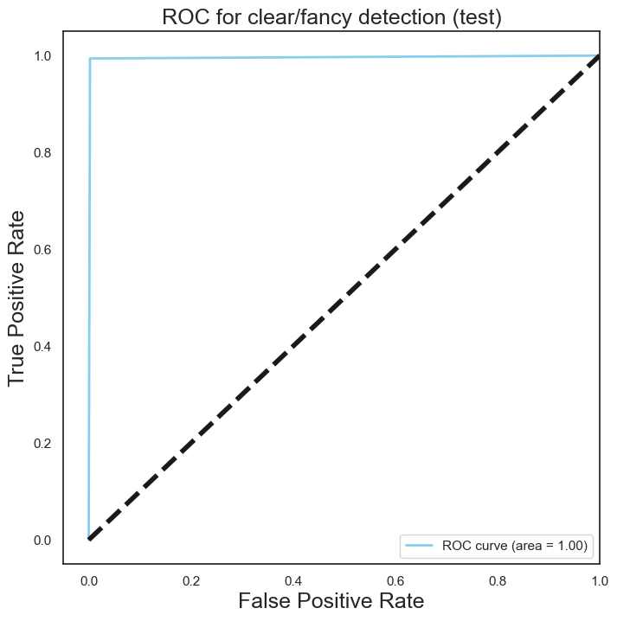
Results
Training
Test

Slide 20
DBSCAN
Can I use DBSCAN to find any interesting relationships in the data?
Distance-based model
Gower’s distance: Alternative to Euclidean distance
Works on disparate data types
Gower’s distance not implemented in scikit-learn—had to compute distance matrix separately & pass to model.
Computing matrix took 40 minutes!
Saved object as python pickle (serialized byte object can be saved to disk). Pickle is 34.7 GB
Good thing I have a new model computer.

Slide 21

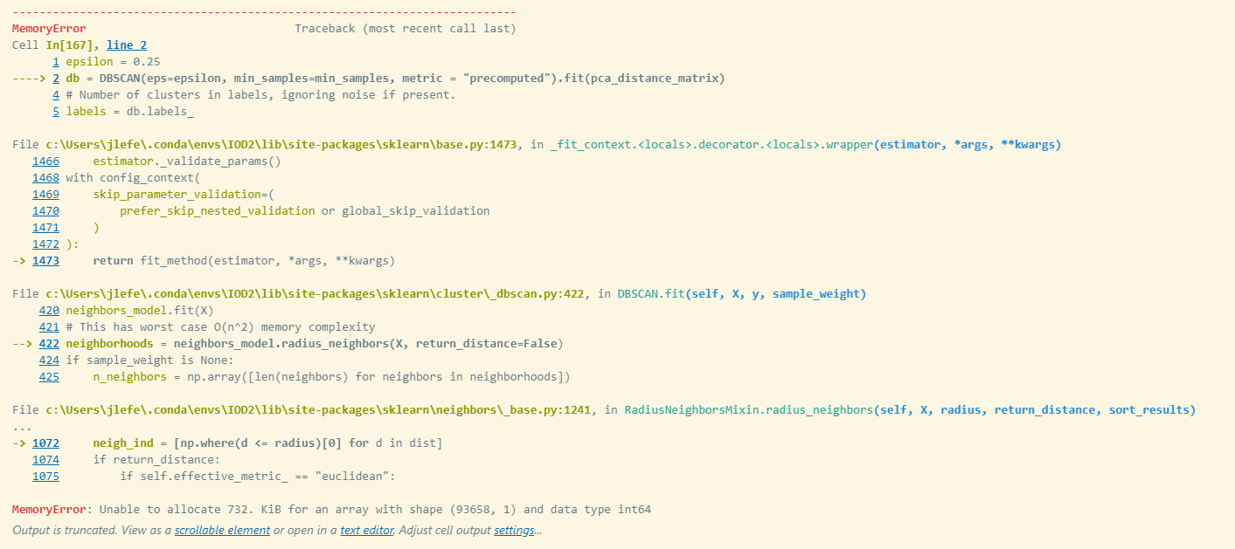
Results
Can DBSCAN find all relationships in the data?
Answer: No
Found 1 cluster, even over several different values for min-neighbors and epsilon distance.
Tried PCA for dimensionality reduction but model keeps crashing.

Slide 22
Summary & next steps

Slide 23
Next steps
DBSCAN
Try just a small group of features.
Perform forward feature selection if possible.
Random Forest
Investigate why the random forest performed so well (too well).
Regression
Explore using a penalty function on the regression to see if that could improve the results.
Try running regression with less extreme values (stronger outlier removal)
Calculate a confidence interval for the regression results

Slide 24
Summary
I learned a lot about working with non-continuous data.
I learned a lot about diamonds.
I learned it takes a lot of decisions when choosing and tuning a model.
Of all 3 models, I am most pleased with the regression. Even though the fit was not strong, at least the result seems valid, which I can’t say about the other two. (The random forest feels fishy, and I wasn’t able to get anywhere with the DBSCAN.)

